Slide 2
ATHENA
Student Account Services Orientation

Slide 3
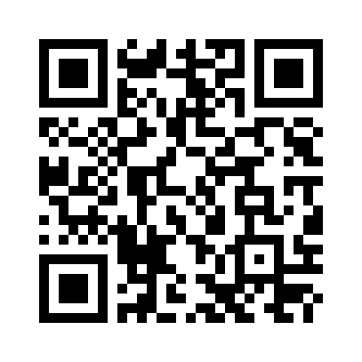
Contact Information
Website: bursar.uga.edu
Contact Us: https://busfin.uga.edu/bursar/contact_sas/ or scan QR Code
Location: 424 E. Broad Street, Athens, GA 30602
Office Hours: Monday – Friday 8:00am-5:00pm (Closed from 12:30pm-1:30pm Daily)
bursar.uga.edu

Slide 4
Payment Deadlines
Fall 2024 dates to remember:
  1st Due Date: August 14, 2024
  2nd Due Date (Drop/Add Activity): August 21, 2024
  Late Fee Assessed: August 26, 2024
  Schedule Cancellation: August 29, 2024
bursar.uga.edu

Slide 5
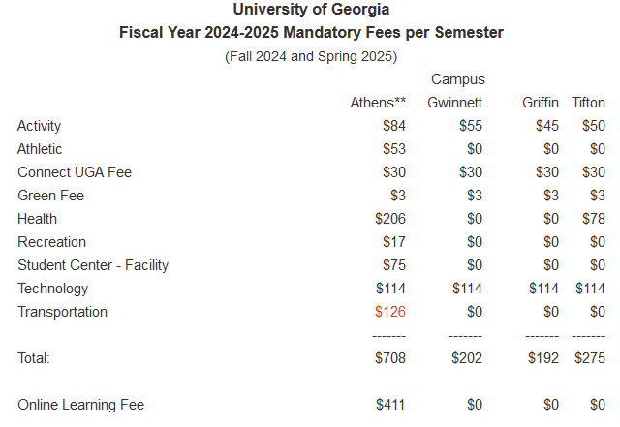
Tuition and Fees per Semester
Flat Tuition Rate
6 or less hrs.
$2,982/$8,983/$9,154
More than 6 hrs.
$5,017/$15,136/$15,424
(in state/ out of state/out of country)
Note: Total Tuition and Fees for the Semester = Tuition Rate + Student Fees
bursar.uga.edu

Slide 6

ATHENA Student Account
Access at athena.uga.edu
Centralized electronic billing system for University charges
  Tuition, Housing, Dining Services, Parking, etc.
Notification Method
  Email - CHECK ON A REGULAR BASIS!
bursar.uga.edu

Slide 7
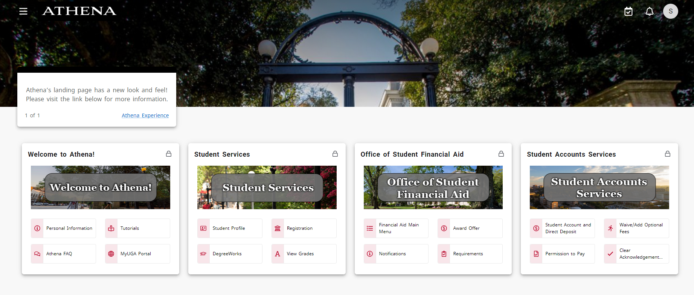
bursar.uga.edu

Slide 8
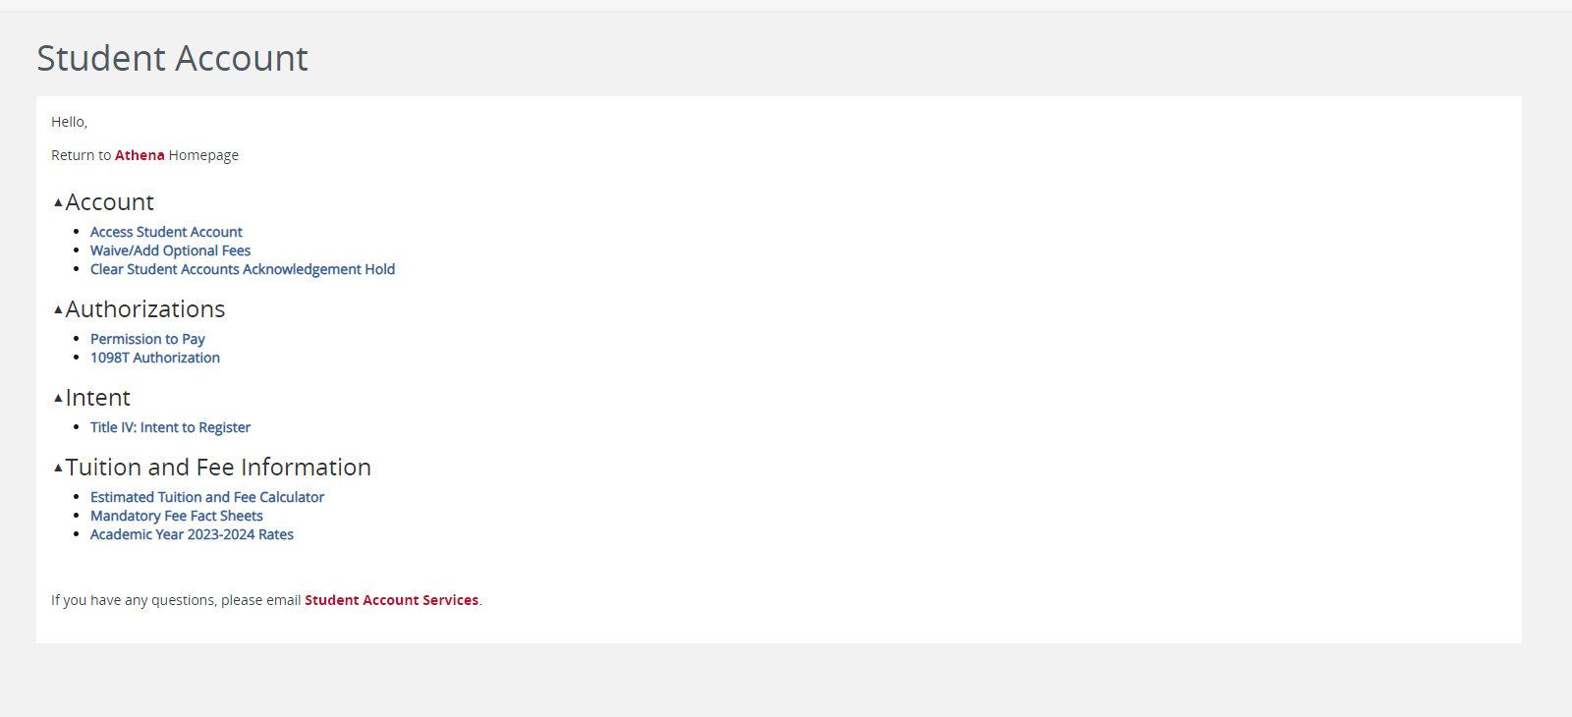

Slide 9
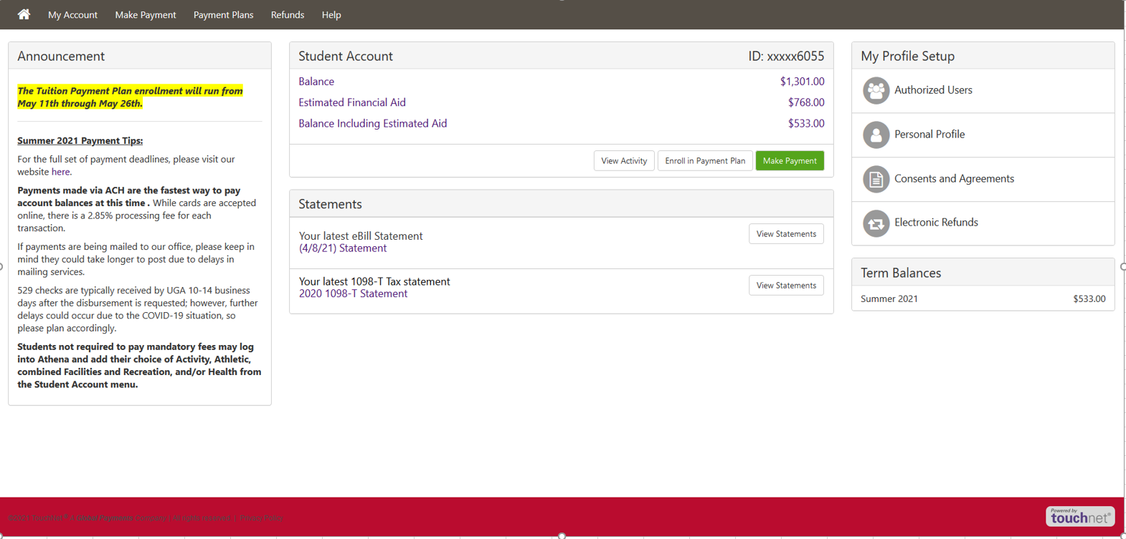
bursar.uga.edu

Slide 10
Understanding Your Account
eStatements
  Printable bill
  Only as current as date on statement
Recent Account Activity
  Any activity after statement date
Balance due
  Statement amount + recent account activity
bursar.uga.edu

Slide 11
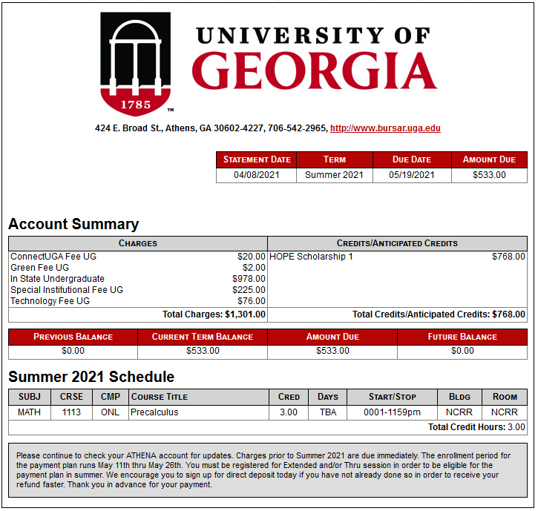
bursar.uga.edu

Slide 12
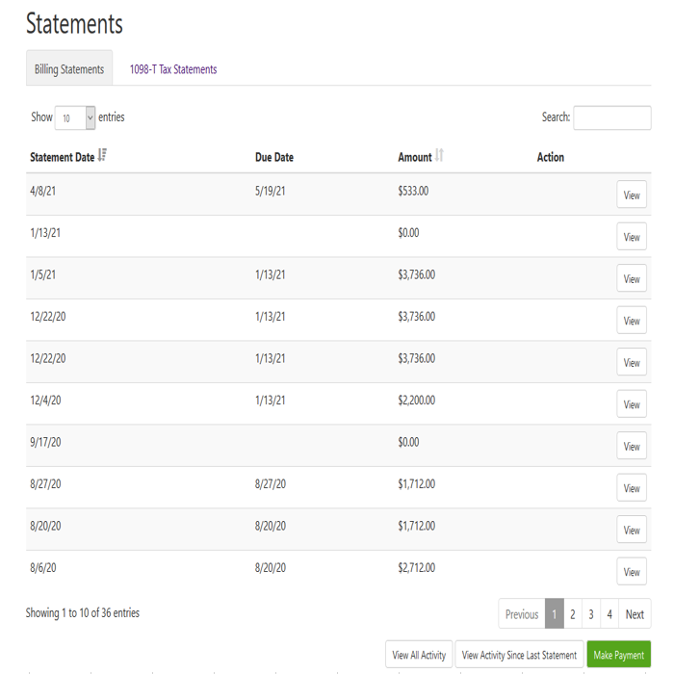
bursar.uga.edu

Slide 13
Payment Options
Online via Student Account
  Credit and debit cards
    Accept MasterCard, Visa, American Express, and Discover
    2.95% convenience fee, minimum of $3.00
  Electronic Check
    No fee associated
    Store multiple bank accounts
  Payment Plan
    $75.00 non-refundable enrollment fee
    Allows payment for up to 50% of the current term’s tuition and mandatory fees, housing, and dining charges or the account balance, whichever is less. The deferred amounts are automatically drafted on predetermined installment dates.
  529 Plans
    Payment should NOT exceed current amount due for the TERM.
    Electronic Payment Option Available directly to UGA for SOME state 529 plans.
    Please allow 10-14 days for processing if you are requesting disbursement via check.
    For more information, see the Payments section of the Student & Parents area at bursar.uga.edu
bursar.uga.edu

Slide 14
Beginning of Semester Checklist
Grant Authorized User Access
  Parents, guardians, employers, etc. with separate access to view/pay bill on student’s behalf
  WILL NOT receive student account emails
Set Up Direct Deposit for Refunds
  Direct Deposit is the approved method to receive financial aid and credit balance refunds.
Permission to Pay
  Student Account menu in Athena
  Allows the student to authorize their Federal and State Financial Aid to pay for ‘other’ charges such as miscellaneous fees, returned check fees, parking, late fees, health insurance, etc.
bursar.uga.edu

Slide 15

Welcome to UGA!
Student Account representatives are available by phone, email, or in person to assist you with any questions you may have about your account or your billing.

